Slide 1




AI Agents Hackathon 2025
FLEETY Your AI Agent for Fleet Management
Alberto
Valenti
PRESENTS
FLEETY: Your AI Companion for Fleet Management Tasks

Slide 2



THE PROBLEM
Where is my fleet, and what are my vehicles doing right now?

Slide 3

THE PROBLEM
Where is my vehicle?
Where is it parked?
The oil level is low; please schedule an appointment with the back office.
What are the next maintenance tasks due for my truck?
What routes did I take by car yesterday?
How fast is the driver driving?

Slide 4






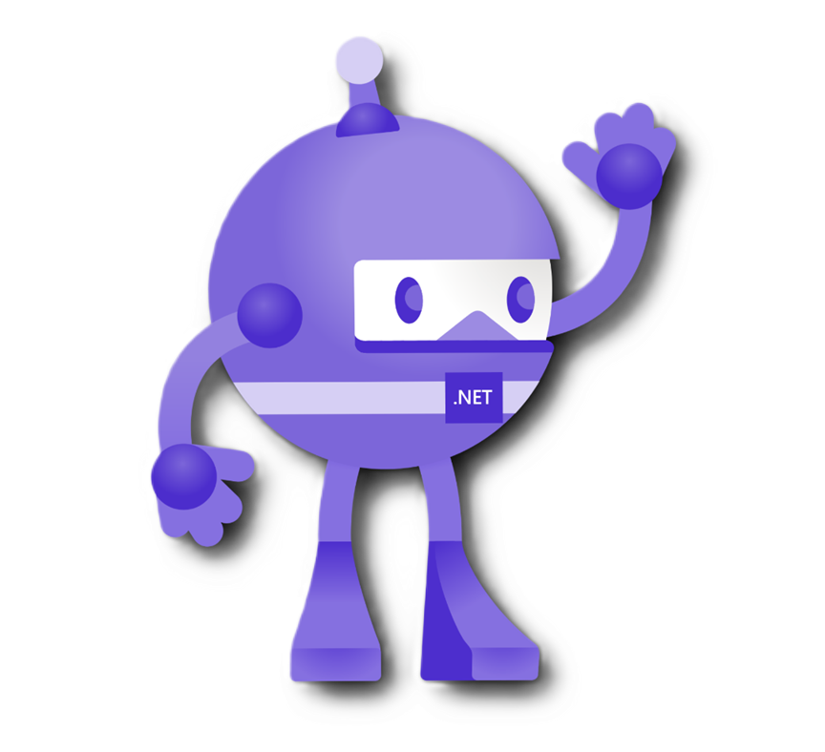

THE SOLUTION
Meet FLEETY Your AI Agent for Fleet Management
Language: C# and .NET 9 Technology Used: Microsoft Azure SQL with Vector Capabilities, Azure OpenAI, Azure Functions, MAUI Client Application, Semantic Kernel, Service Fabric
Azure Maps

Slide 5

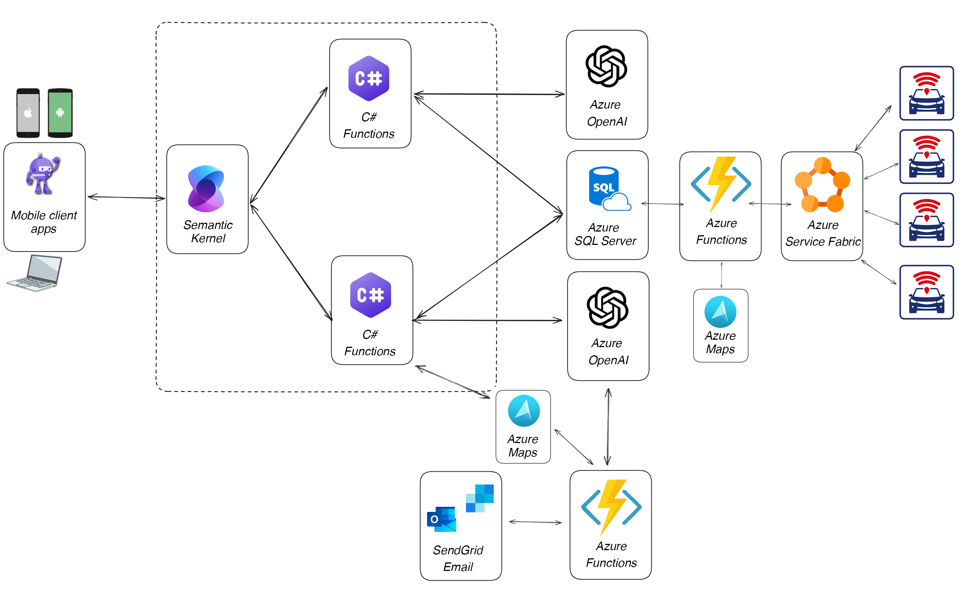
THE SOLUTION
FLEETY: Your AI Companion for Fleet Management Tasks

Slide 6






THE SOLUTION
Real-time locations are transferred to the Service Fabric service using the tracker's proprietary protocol (TCP/UDP). Service Fabric validates the data and forwards it to an Azure Function, which handles geocoding coordinates into addresses using Azure Map Services and saves them to Azure SQL Server
1
POSITITIONTRACKING
Technology Used Azure Map Services Azure SQL Server Service Fabric Azure Function
Language
ZeroBlu SRL | Via Maroncelli 5 | Pontedera (PI) | app@business-central.app | + 39 371 0129.678
FLEETY: Your AI Companion for Fleet Management Tasks

Slide 7









THE SOLUTION
Where is my vehicle?
Where is it parked?
The oil level is low; please schedule an appointment with the back office.
An intelligent agent embedded in a Maui mobile application empowers users to make inquiries effortlessly. It provides information about vehicle location, speed, address, and activities from previous days, while also allowing users to review maintenance plans and submit requests directly to the back office.
What are the next maintenance tasks due for my truck?
2 AGENT APP
What routes did I take by car yesterday?
How fast is the driver driving?
Technology Used Azure Open AI Chat Model Azure Embedding Model Semantic Kernel MAUI App
Language
ZeroBlu SRL | Via Maroncelli 5 | Pontedera (PI) | app@business-central.app | + 39 371 0129.678
FLEETY: Your AI Companion for Fleet Management Tasks

Slide 8






THE SOLUTION
An automated agent, running with a trigger, sends specific communications. In the morning, it proactively provides the address and location where the vehicle is parked. It can also be integrated with third-party services to assess situations, such as whether the vehicle needs to be relocated due to street maintenance
3
AUTOMATED AGENT
Technology Used Azure Open AI Chat Model Azure Embedding Model Semantic Kernel Azure Function
Language
ZeroBlu SRL | Via Maroncelli 5 | Pontedera (PI) | app@business-central.app | + 39 371 0129.678
FLEETY: Your AI Companion for Fleet Management Tasks

Slide 9






FEATURES AND BEFEFITS
Agent for IOS, Android and Windows Effortless Mobile-Friendly Design: Manage Tasks with Ease Anytime, Anywhere..
Find it! When a driver needs to locate their vehicle, they can simply ask the AI agent for its parking location. Easily locate where your vehicle is parked by asking the AI agent for its precise location
01
04
Harnessing the Power of AI Effortlessly communicate with an intelligent agent in natural language—no need for complex systems or technical jargon
02
05
Maintenance The AI agent proactively informs you of upcoming maintenance due dates, keeping your fleet in optimal condition..
AI Agents: Instant Alerts The Agent Alerts You Instantly in Case of Any Problems, Ensuring Prompt Action and Resolution.
03
06
Easily send requests Easily submit a claim or request instantly by communicating in natural language with the AI agent.
FLEETY: Your AI Companion for Fleet Management Tasks

Slide 10
THE SOLUTION AT A GLANCE
01
02
03
04
Real time tracking Your Fleet is Efficiently Tracked Inside SQL Server.
Artificial Intelligence Users can effortlessly ask for information using natural language, making interactions smooth and intuitive.
Immediate alert Effectively Monitor Your Entire Mobile Workforce and Fleet Vehicles.
Check anywhere Access and Check Your Fleet Status Anytime, Anywhere.
FLEETY: Your AI Companion for Fleet Management Tasks

Slide 11

FLEETY
Your AI Companion
For Fleet Management Tasks
Real time tracking Real-Time Fleet Management: All Vehicle Positions at a Glance.
Artificial Intelligence AI Agent: Effortless Fleet Maintenance, Redefining Simplicity Like Never Before
Keep tabs Take Control of Your Workforce Fleet with Ease
Communications Instantly Communicate with Your Fleet Manager for Quick Updates and Coordination.
Alerts Receive Alerts to Locate Vehicles Quickly and Efficiently
FLEETY: Your AI Companion for Fleet Management Tasks

